Slide 1
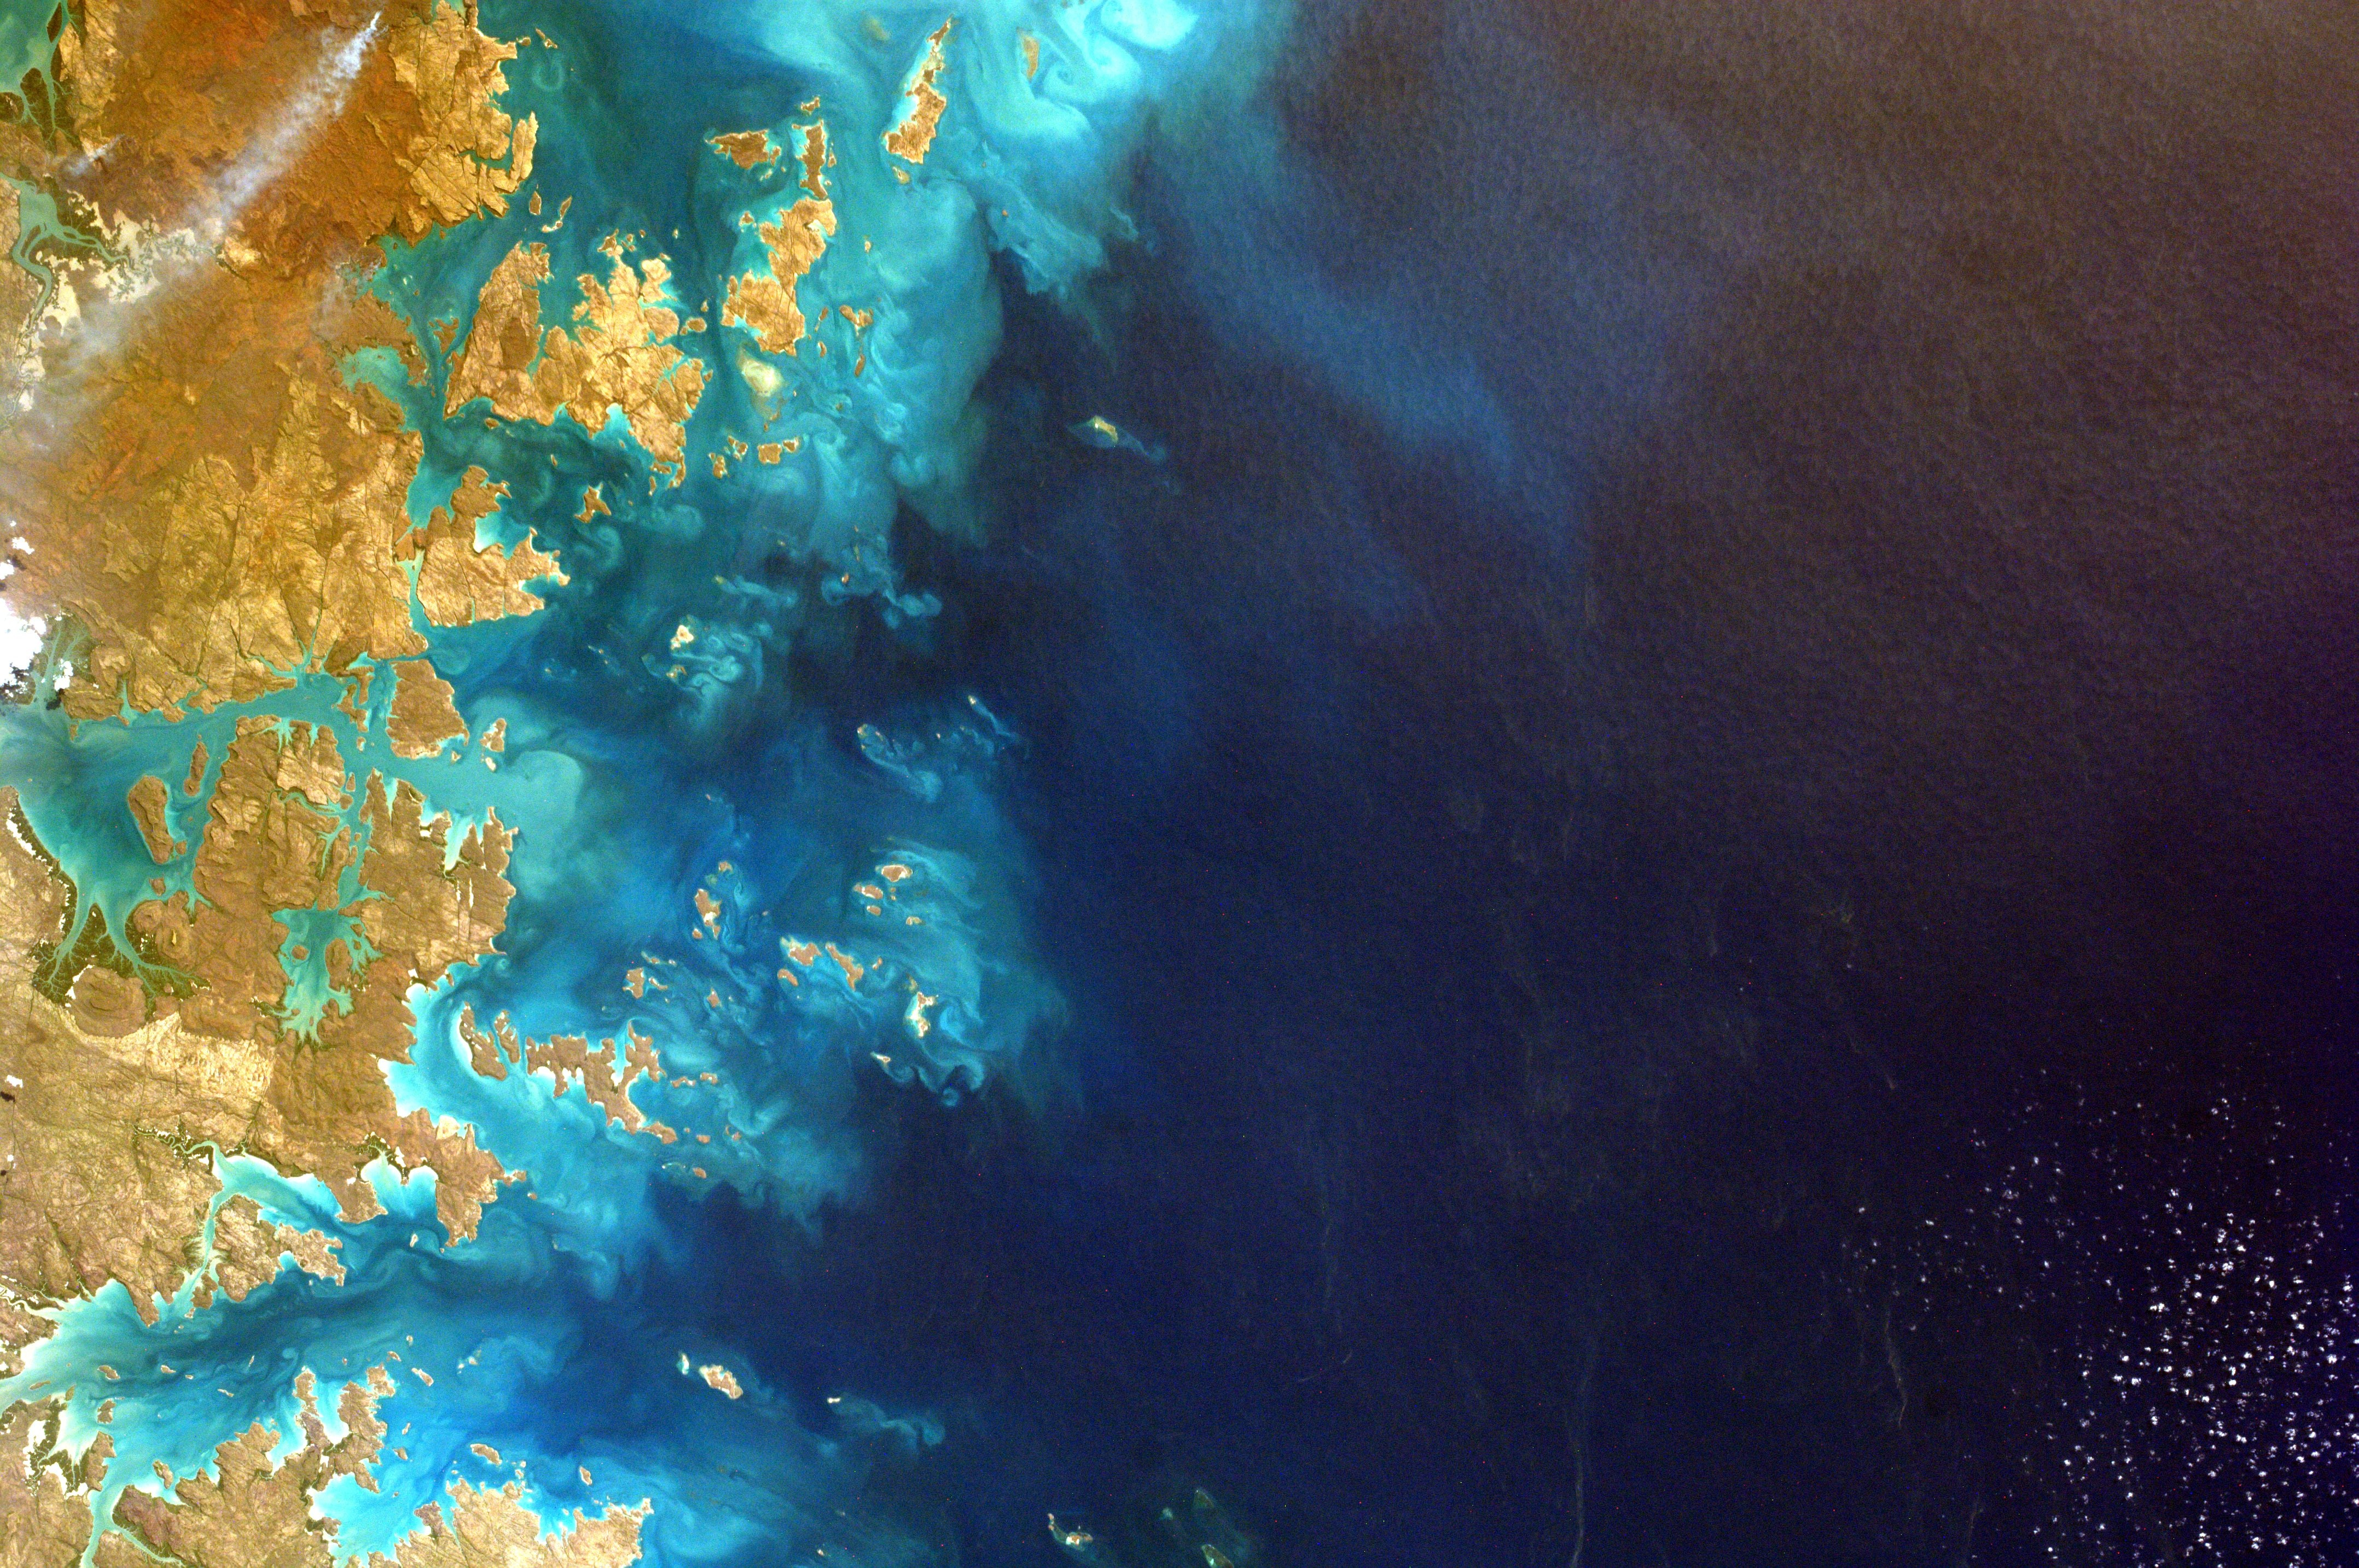




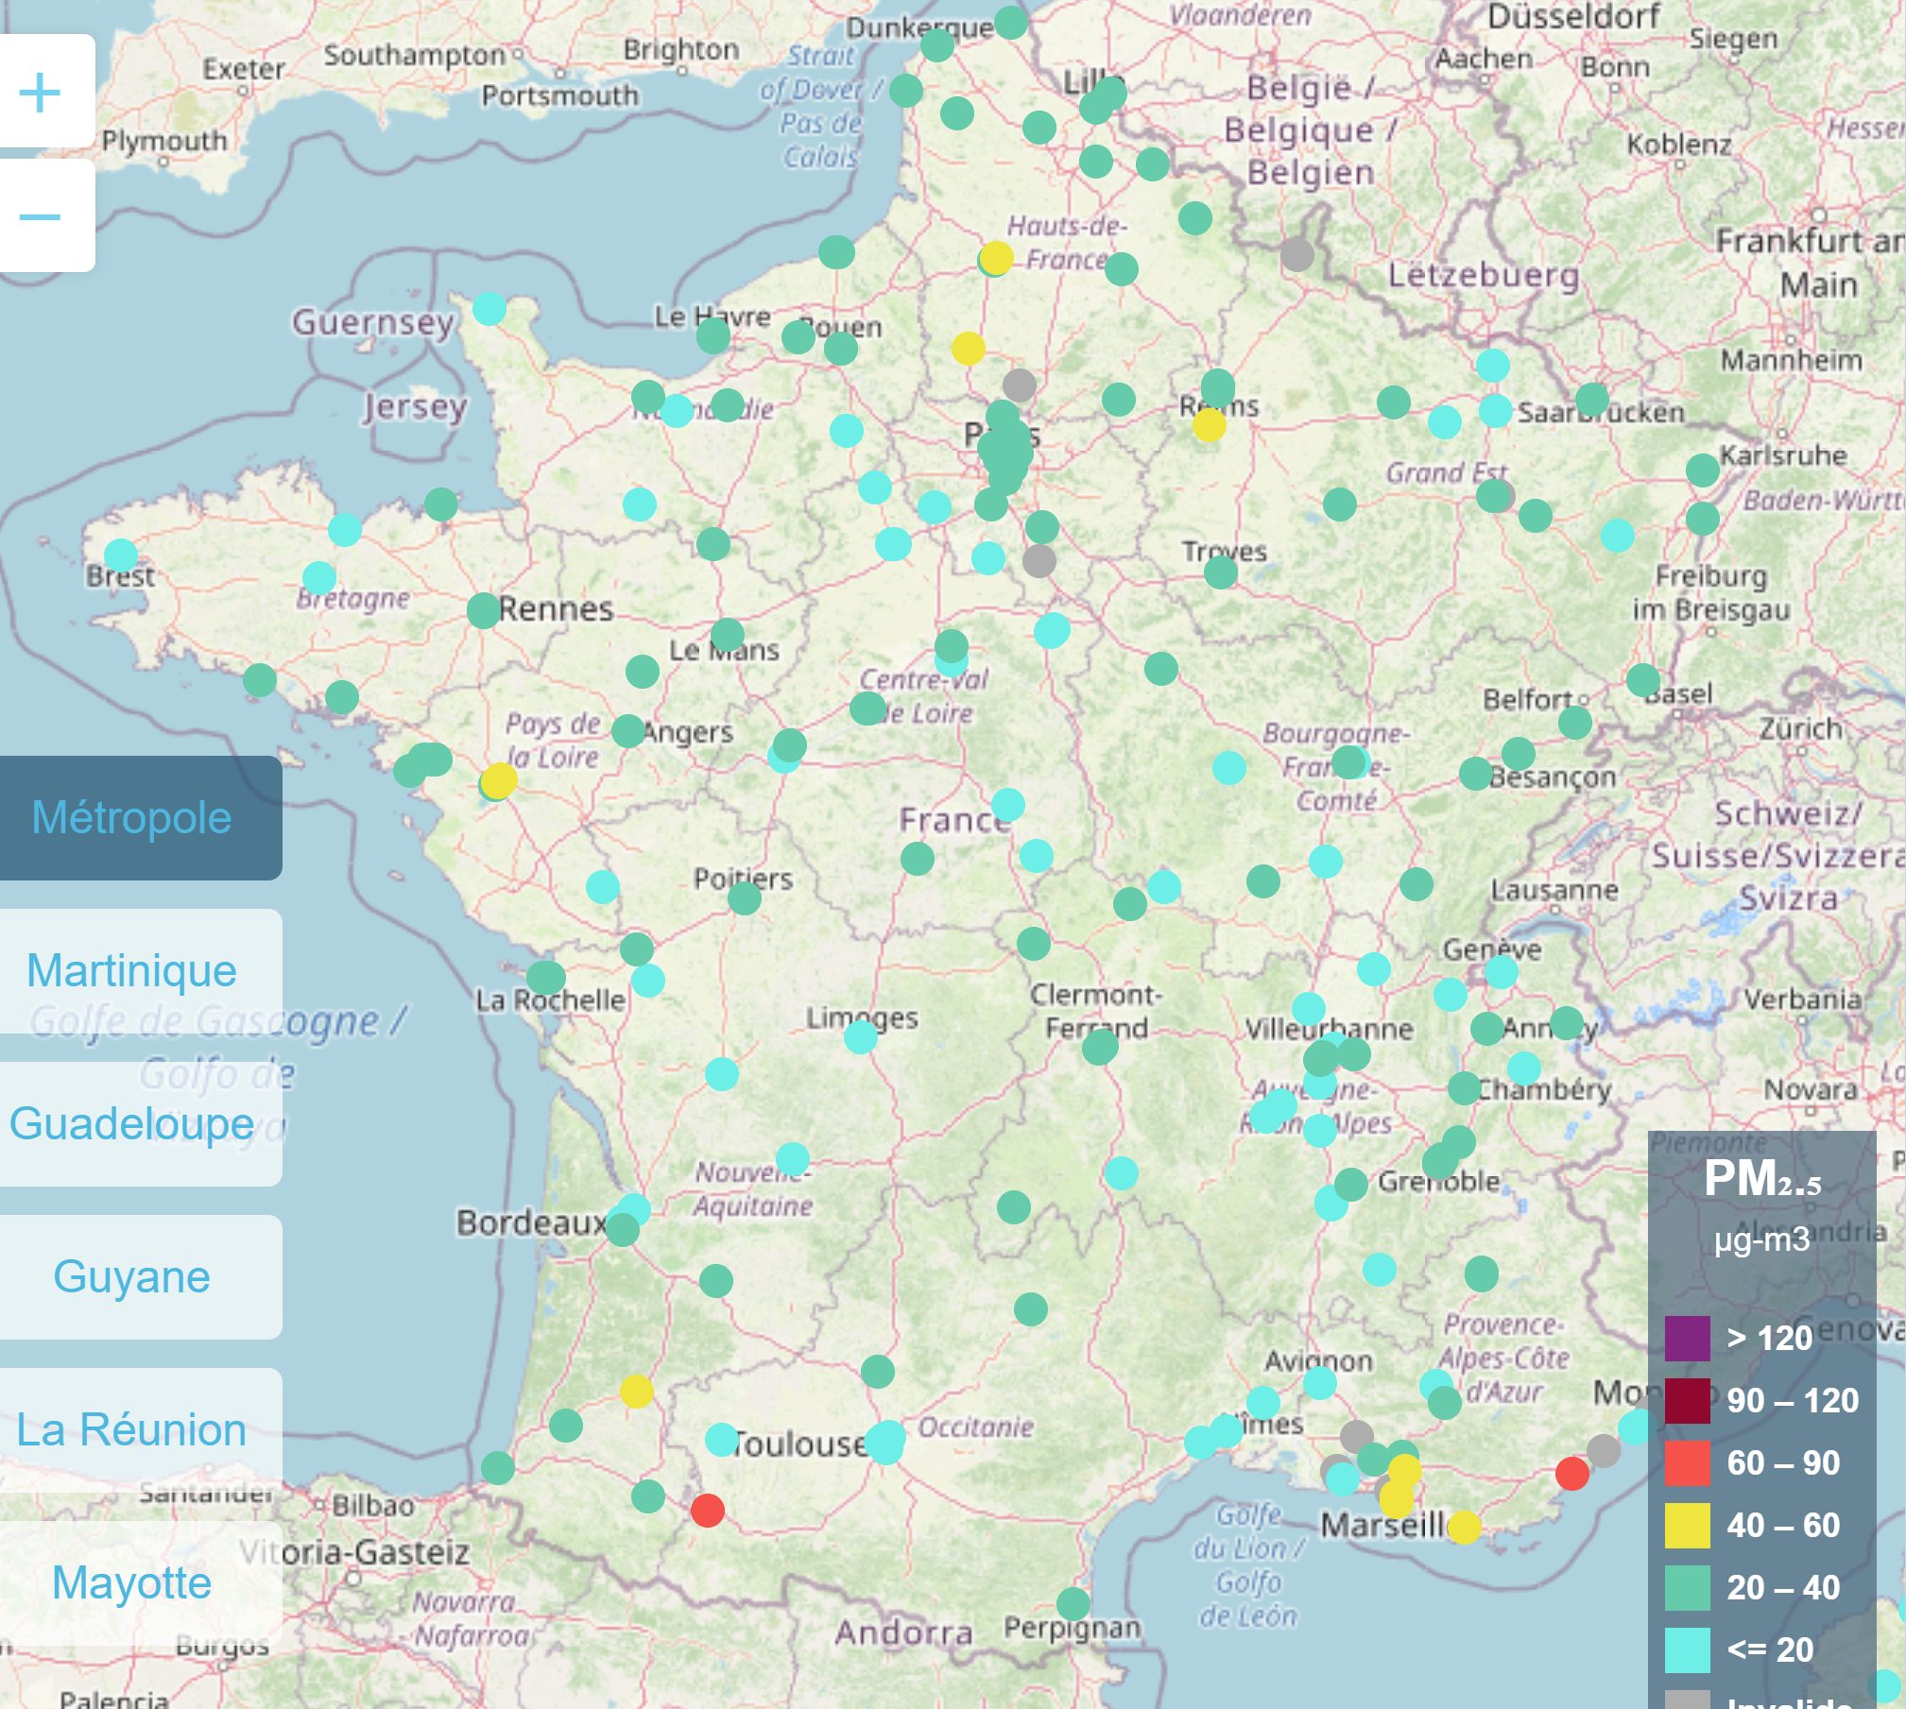
NEOS
Air agents
Water agents
NEoplasm Open-Source Environmental Risk Factors Standardization
Challenge 2
Pascal Deschaseaux¹, MD, MBA; Sébastien de Longeaux¹, MBA; Edouard Debonneuil², PhD; Rachel Aronoff³, PhD
CHALLENGE: accelerating the research of cancer risk factors by structuring open data completing the OSIRIS clinical and omics data structure in order to include variables related to the environment (structuring, terminology, interoperability,..)
SCOPE:
Other diseases
Prognostic factors
Behavioral & occupational
Other agents
IARC groups
2A, 2B, 3
Private sources
Rest of World
Care
Cancer
Risk factors
Environmental
Air & water
IARC Group 1
Open sources
France
Epidemiology
OBJECTIVE: easing environmental cancer risk factors data interoperability, exchange and further analysis by structuring, harmonizing an sourcing a minimal epidemiological data set, in a FAIR approach
RISK FACTORS SELECTION:
Easily measurable → air & water agents, France
International reference → IARC (International Agency for Research on Cancer, Lyon, France) monographs
Scientifically proven → IARC group 1 carcinogens (substances known to have carcinogenic potential for humans, classification is largely based on human evidence)
EXAMPLES CHOSEN:
From a resulting list of 37 Group 1 air & water biological, chemical and physical agents with open sources, we selected 2 carcinogens:
An air pollutant: PM2-5 (fine particle matter), associated with lung cancer risk
A water pollutant: arsenic, associated with lung, urinary bladder and skin cancer risk
WORK PACKAGES:
WP1: ontology
WP2: data & metadata
WP3: data sources
TARGET OUTCOME:
Standardized air & water epidemiology dataset framework & examples
CONCLUSIONS:
Environmental data are very heterogeneous
Two types of data are key: place of residence/occupation, duration of exposure
Variables definition must be very precise and contextualized to avoid biases
The place of agent measurement, and its geographical coverage are possible limiting factors, particularly for rural areas
Data collection and analysis at the individual level require a precise address and geocoding
This work must now be expanded to the other IARC Group 1 agents using the NEOS framework
NEOS FRAMEWORK (SELECTED FIELDS):
Item group, objectives, item N°, collection status, item, item definition, expected value
Geographic location of measure, geographic granularity of measure, date of measure, data source, reliability of use
Main cancer sites associated with agent, reference value, guidelines, monograph/backup paper, main sources of exposure
Consent (if needed)
Current address, for how long, past addresses (starting with most recent, as detailed as possible), for how long (years) for each past address, main occupation, usual place of main occupation, for how long (years), main mode of transportation, how many days a month, how many hours a week
Exposure to carcinogen (concentration in medium)
Max PM₂.₅ mean hourly concentration in France as of Jan 11, 2022
showing discontinuity of measurement coverage (source: Geodair)
https://github.com/Epidemium/NEOS
1 NewClin, 2 International Longevity Alliance, 3 Hackuarium
Acknowledgements: we thank the organizers of the Epidemium challenge (Roche, the operational team) as well as the project mentors (Mehdi Benchoufi, Julien Guérin, Bastien Rance, Hector Countouris) and reviewers

